Slide 1
Super Store Sales Report
PRESENTED BY MEHAJABIN ANSARI

Slide 2
Overview
In this project, I designed an interactive business dashboard using Power BI/Tableau. The goal was to analyze a sales dataset and present key insights in a simple, visual and decision-focused format.
The dashboard helps business stakeholders quickly understand Sales, Profit, and Growth trends and make informed decisions.
2

Slide 3
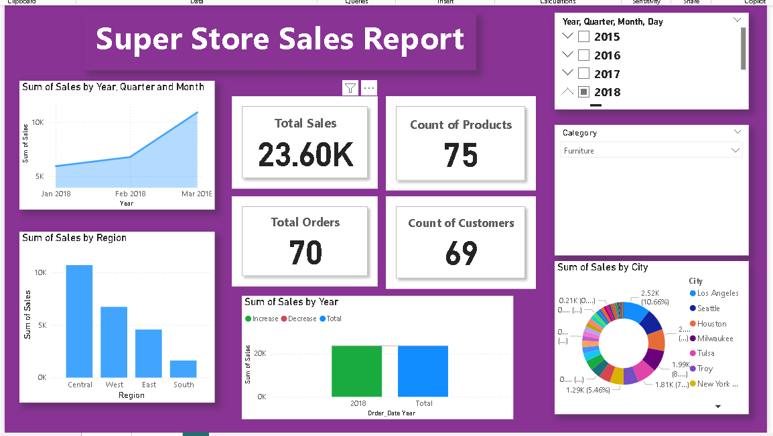
4

Slide 4
Cards
TOTAL SALES
TOTAL ORDERS
COUNT OF PRODUCTS
COUNT OF CUSTOMERS
5

Slide 5
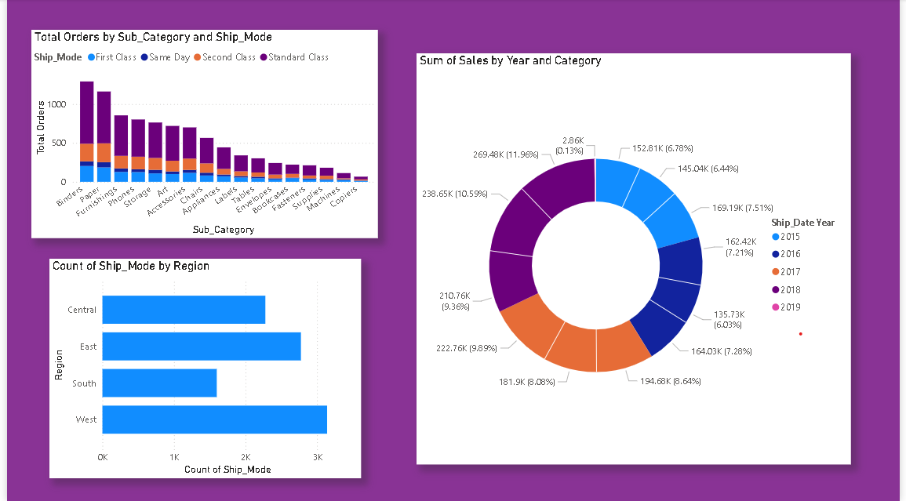
LET'S WORK TOGETHER
9

Slide 6
THE END
Thank You

